Slide 1




EXPRESS
SOLUTIONS

Slide 2

TRANSPORT AND ROAD SAFETY
MISSION | To resolve the time consuming process of multiple checking at checkpoints through out the journey of the consignment

Slide 3

GPS Tracking and Fleet Management
Intelligent Route Planning
Electronic Toll Collection
Data Analytics and Predictive Analysis
Automated Incident Reporting and Response
Communication and Collaboration Platforms
EXISTING SOLUTIONS

Slide 4


EXPRESS SOLUTIONS
EXISTING IDEA VS PROPOSED IDEA
To implement secured transportation of goods
using rfid tamper evident seal on a large scale

Slide 5
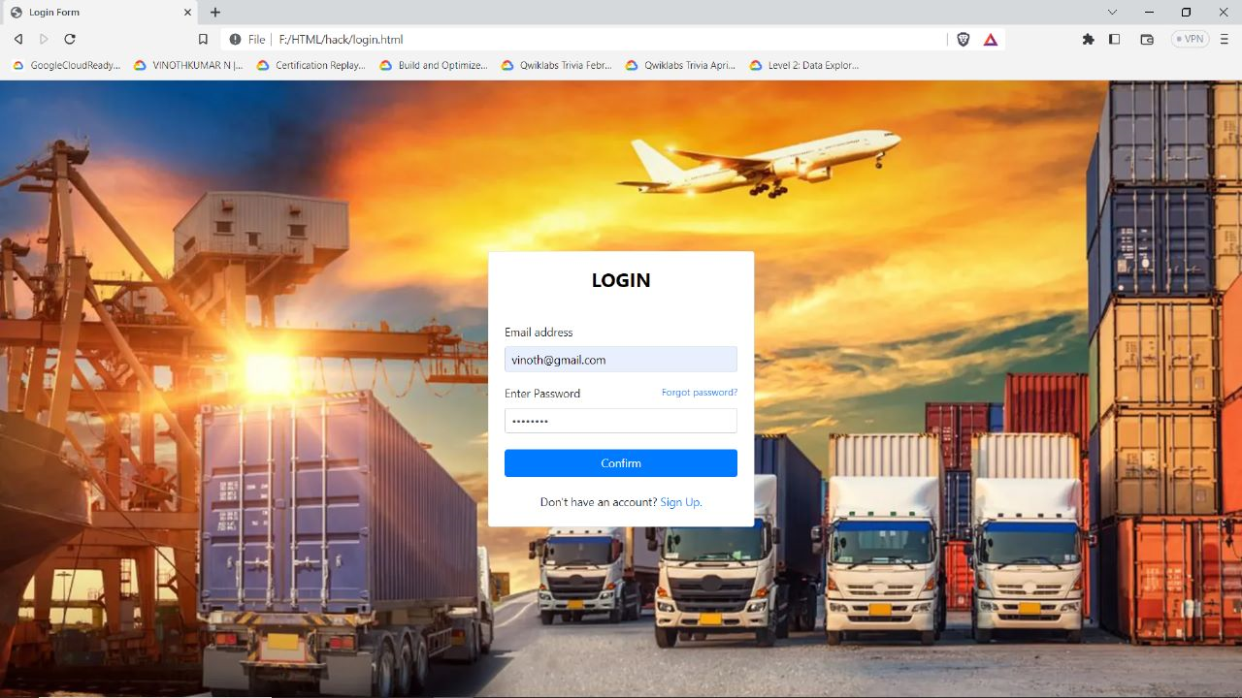

Slide 6
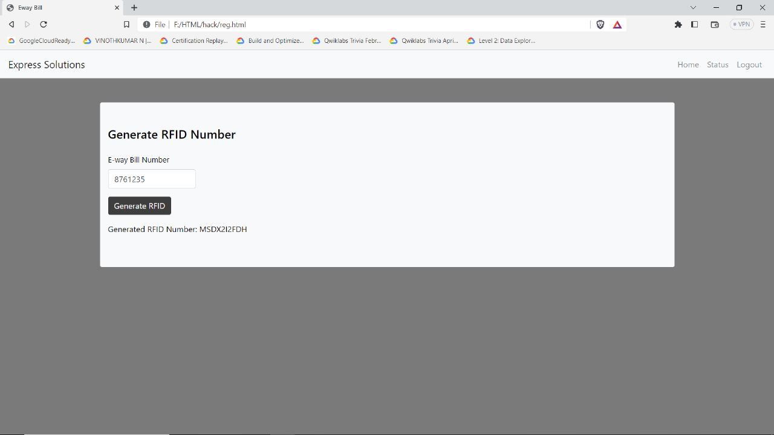

Slide 7

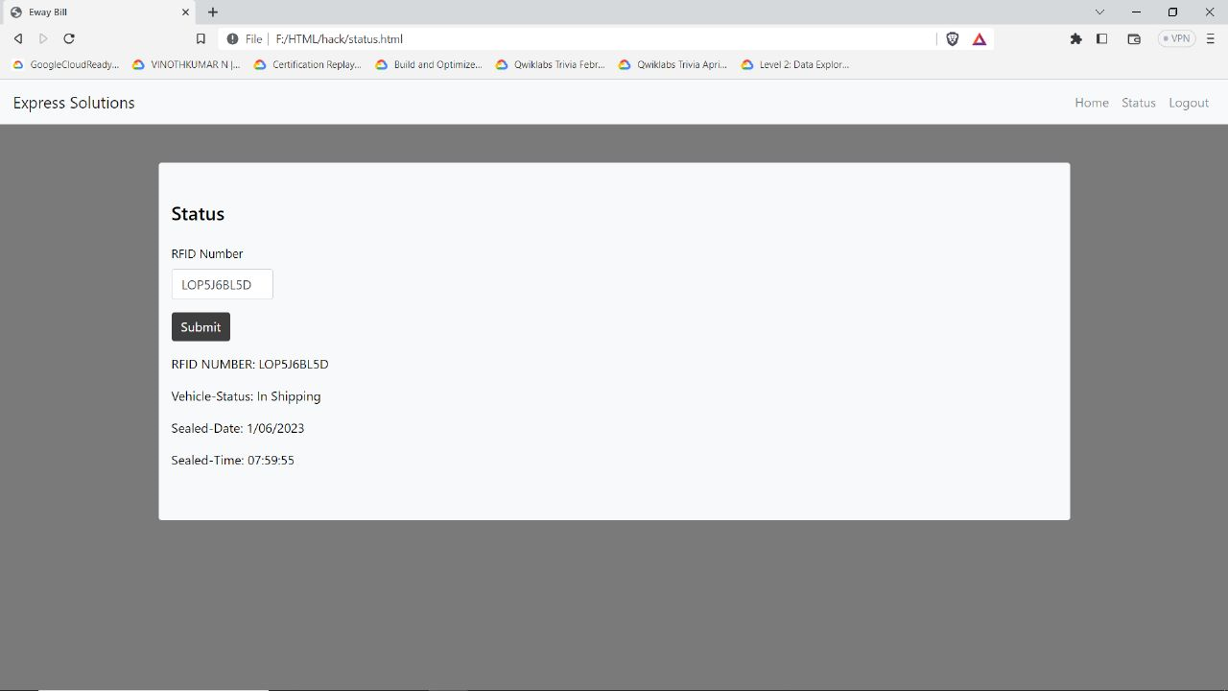
Drag and drop your photo or video! Click the sample photo or video and delete. Select yours from the uploads tab, drag, and then drop inside the frame!

Slide 8


Slide 9
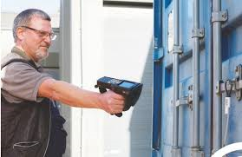

Slide 10

Our Management Team
VINOTHKUMAR N | CHIEF EXECUTIVE OFFICER
ANAS H | CHIEF FINANCE OFFICER
KAVIN B | DIRECTOR
DEEPAK K | CHIEF OPERATING OFFICER

Slide 11
THANK YOU

